Slide 1
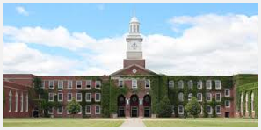
INTEGRATED SPREADSHEETS AS A PARADIGM OF TYPE II TECHNOLOGY APPLICATIONS IN MATHEMATICS TEACHER EDUCATION
SERGEI ABRAMOVICH
STATE UNIVERSITY OF NEW YORK AT POTSDAM, USA

Slide 2
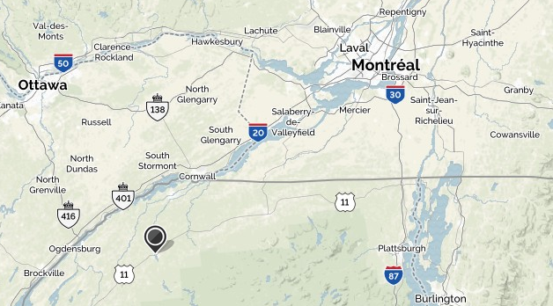
Geography of SUNY Potsdam

Slide 3
A graduate level secondary mathematics education capstone course
or "a capstone course sequence in which conceptual difficulties, fundamental ideas and techniques of high school mathematics are examined from an advanced standpoint" (Conference Board of the Mathematical Sciences, 2001, p. 39)

Slide 4
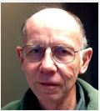
Two types of technology application: Type I & Type 2 (Maddux, 1984)
Type I – surface structure of
signature pedagogy
Type II – requires acting at the deep structure of signature pedagogy dealing with uncertainty, motivating engagement, and enabling formation

Slide 5
Structures and descriptors of signature pedagogy (Shulman, 2005)
Surface structure
Deep Structure
Implicit structure
Uncertainty
Engagement
Formation

Slide 6
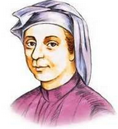
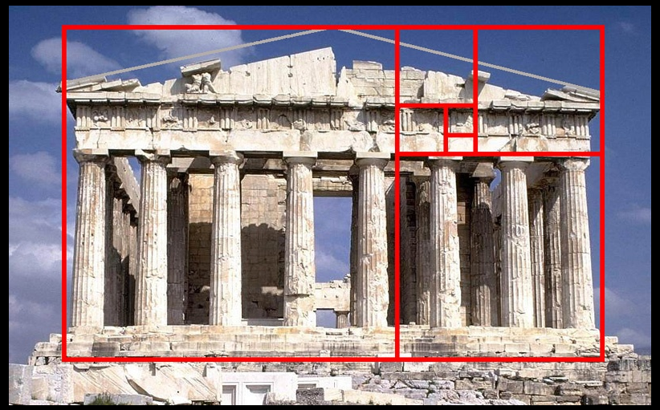
FIBONACCI NUMBERS AND THE GOLDEN RATIO
1170-1250 AD
432 BC

Slide 7
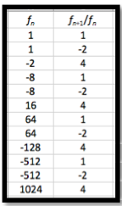
FROM THE GOLDEN RATIO TO GENERALIZED GOLDEN RATIOS
CYCLE OF LENGTH THREE !!!

Slide 8
FROM THE GOLDEN RATIO TO GENERALIZED GOLDEN RATIOS
Spreadsheet-based
experiment
The Ratios may form cycles of any given length

Slide 9
Capstone course assignment: Consider the equation a modification of the equation
Using an integrated spreadsheet (Maple, Wolfram Alpha and the Graphing Calculator), find a and b responsible for the cycles of period seven, that is

Slide 10
Using Maple

Slide 11
Using Maple

Slide 12
Using Maple

Slide 13
Using Wolfram Alpha
x = a²/b

Slide 14
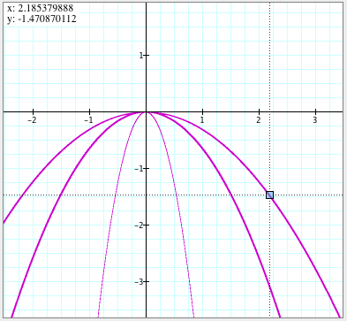
From Maple to the Graphing Calculator

Slide 15
Spreadsheet confirms cycle of period seven

Slide 16
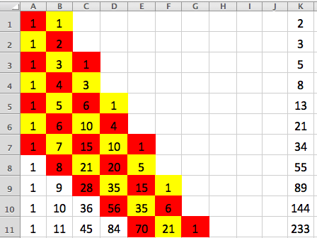
From Pascal’s triangle to an open problem in mathematics: Fibonacci-like polynomials don’t have complex roots
Maple-based proof for n ≤ 100

Slide 17
Conclusion
“This project allows a perspective [sic] math teacher to achieve a deeper understanding of content material which translates to a better educational experience for students in the classroom. Furthermore, the use of technology present in these explorations is stressed as an essential component of education by each of the three groups. It is for these reasons that this project, through its relation to the goals and expectations set forth by these groups, serves as an appropriate capstone experience.”

Slide 18
2015

Slide 19
THANK YOU
abramovs@potsdam.edu
http://www2.potsdam.edu

